Slide 1
Magnetic Force on a Wire

Slide 2
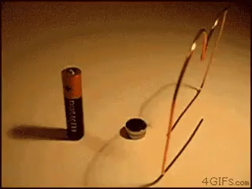
By the end of this lesson, you should be able to:
Explain how you find the direction that the magnetic force acts in.
Calculate the magnitude of the magnetic force.

Slide 3
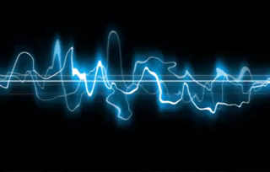
When a charged particle moves through a magnetic field, a magnetic force acts on it.
A current-carrying wire contains many charged particles that are all travelling in the same direction. This means that a magnetic force is also applied to current-carrying wires when they pass through magnetic fields.
We will look at current-carrying wires before single charged particles because the current always flows in the same direction, while the particle curves around as the magnetic force acts on it. This makes current-carrying wires easier to understand than single particles.

Slide 4
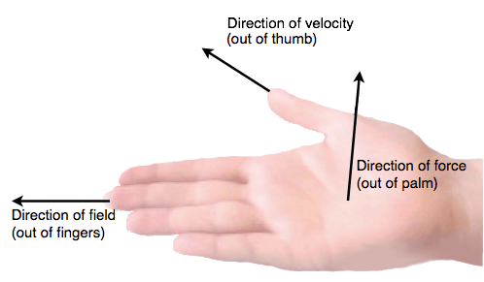
We use the right-hand slap rule to find the direction that the magnetic force acts in.
Point the thumb on your right hand in the direction that the current in the wire is flowing in. Then point your fingers in the direction of the magnetic field.
Now the palm of your hand is facing the direction that the magnetic force is acting in.

Slide 5

You can remember this because when you slap someone, you apply a force to their face.
Therefore, the palm of your hand corresponds to magnetic force. Just make sure you remember to use your right hand!

Slide 6

Let's look at an example.
Say there is a wire with a current flowing from left to right and it is passing through a magnetic field that points straight away from you.
Which direction do you think the magnetic force on the wire will act in?
Try to use the right-hand rule first then look on the next slide for an explanation.

Slide 7
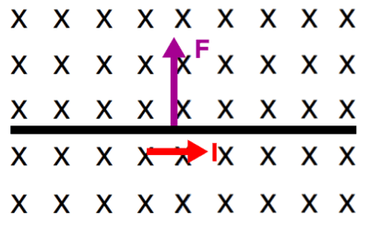
Here's how you use the right-hand rule in this situation:
Point the thumb on your right hand to the right. Now turn your hand so that your fingers are pointing away from you. Your palm should now be facing up.
This means that the magnetic force acting on the wire points up! Therefore, the wire will move up.
F represents force and I represents current. Remember, crosses represent a magnetic field that points away from you.

Slide 8

We use this formula to calculate the magnitude of the magnetic force when current and magnetic field are perpendicular:
F=BIL
In this formula, F is the magnetic force, B is the magnitude of the magnetic field, I is the magnitude of the current and L is the length of wire in the magnetic field.
Notice how we are only dealing with magnitudes here - you still need to use the right-hand rule to find the direction of the magnetic force.

Slide 9

We need to be careful to use the right units when we do this calculation.
Magnetic force must always be in newtons (N).
Magnetic field strength must be in teslas (T).
Current must be in amperes (A).
The length of the wire must be in metres (m).

Slide 10
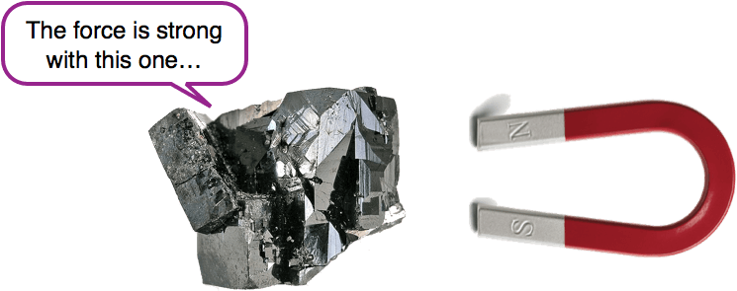
Make sure you always check the units you are given before you perform your calculations!
You probably won't be given magnetic field strength in teslas though - you are much more likely to be given it in microteslas (μT) or milliteslas (mT). This means that you will need to convert the magnetic field strength into teslas before doing the magnetic force calculation.
A millitesla is a thousandth of a tesla. This means that to convert milliteslas to teslas you need to divide by 1000.
Similarly, a microtesla is a millionth of a tesla. You divide by 1,000,000 to convert these into teslas.

